Slide 1
JourNear A journey sharing app
- Akshay Mathur (19301666)
- Nikhil Girraj (19315753)
- Sarvani Chakrabarty (19305730)
- Sujit Jadhav (19310363)
- Taranvir Singh (19303699)
- Utkarsh Bhardwaj (19305458)
Notes:
Journey sharing is an evolving practice, especially in metropolitan areas, which comes with its own difficulties. Current mobile applications that facilitate this scenario highly depend on Internet connectivity to operate. In addition, situations where a high number of users connect to the Internet (for example, at the end of a game at stadiums) the Internet connectivity itself becomes a scarce resource.
JourNear aims at solving these challenges. Our Application is for travellers to find compatible fellow-travellers to share a journey. The option of accessing the application in offline mode erases the usual network issue which is faced often by users. The upcoming sections make a brief walk through on the methodology adopted to develop the application.

Slide 2
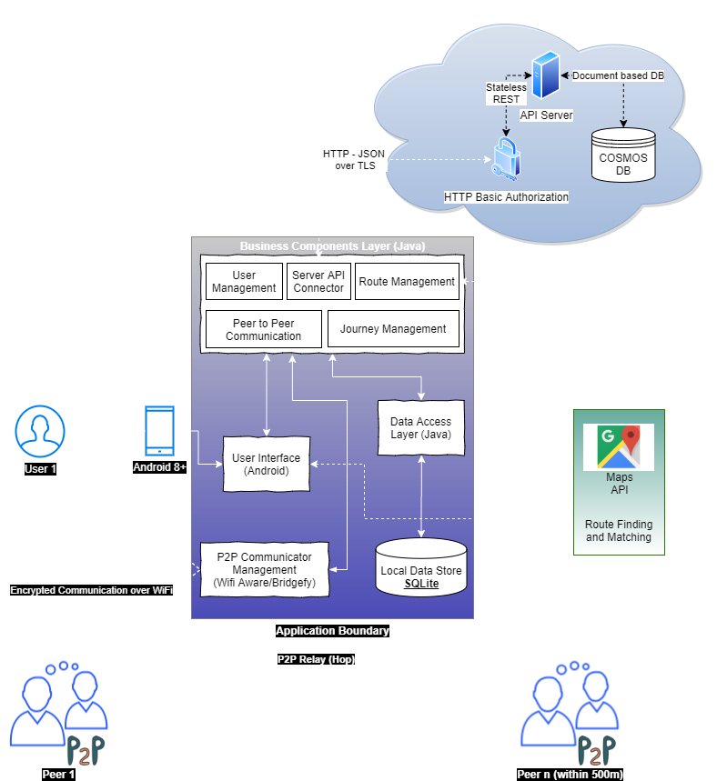
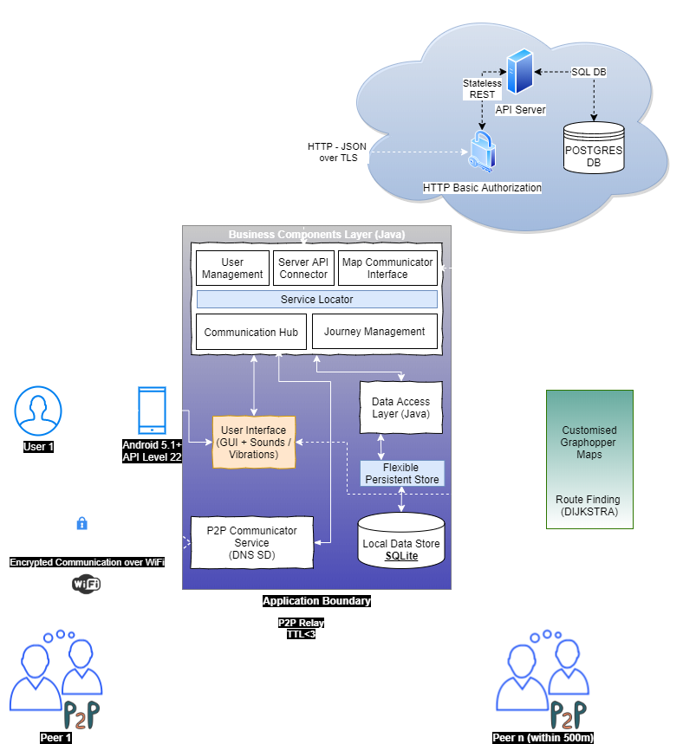
Architectural Iterations
Iteration 1
Iteration 2
Notes:
We start with the architectural iterations adopted over the project timeline. DNS Service Discovery was selected to model peer-to-peer network instead of Wifi Aware or Bridgefy which were initially chosen to be implemented. Google maps was replaced with customised implementation of graphhopper maps with route finding using graph search algorithms like Dijkstra and A star. Android API level 22 has been finally used and AES 256 is used for Encrypted Communication. Also, the Azure server is replaced with a Flask server placed in Heroku’s Container. The server uses PostgreSQL server instead of COSMOS DB.

Slide 3
Components
Features
P2P Communication
DNS based Service Directory
Maps
Open Street Maps
Graphhopper API
Security
AES algorithm to encrypt data
SHA 256 to hash user’s profile password
Fault Tolerance
Ethics
Flexibility
Notes:
Multiple components to achieve peer to peer communication were tried out such as Bridgefy, WiFi Aware, Hype Labs and WiFi Direct but due to some challenge or the other, they couldn't be integrated. Then we came across DNS Service which is a way of using standard DNS programming interfaces, servers, and packet formats to browse the network for services. This approach turned out to be successful as only devices having the JourNear App are listed.
We used Graphhopper an open-source API to build maps using the OSM (Open Street Map) format and used the map component to provide offline navigation and geocoding for effective location selection.
To keep the system secured, AES algorithms has been used to encrypt the data while communication is being held among devices. User’s account password is hashed using SHA 256.
The system has been made fault tolerant. It executes when offline by using Connection-less WiFi mode. The application saves data on server as well on local mobile SQLite database in the event of application crash.
The application solves ethical challenges. Provision has been provided where users will be asked for permissions to use their locations and device storage. The application performs the required functionalities once the user accepts the permissions. This has been mitigated by allowing the app to use these services only while it is in use by the user and not in the background.
The system is made flexible by adding every bit of constants to a common Constant file. For example, changing the database API can be done using the constants file instead of changing it everywhere in the code.

Slide 4
Peer Communication via DNS - Service Discovery
Android API - WifiP2pDnsSdServiceRequest
Exposes the service on the network using standard DNS API over WiFi
Communication using Broadcast-Broadcast messages
Uses 256 bit AES encryption
Participating nodes only decrypt the packets which are addressed to them or broadcasted
Equivalent of communication on a Walkie-Talkie where the service name is analogous to specific frequency
Our communication layer on top of DNS-SD ensures Ack of sent messages.
Notes:
We take a deeper dive into peer communication via DNS Service Directory.
The Android API Service Request mentioned exposes the service on the network using standard DNS API over Wifi.
Communication is carried out using Broadcast messages using 256 bit AES encryption.
The nodes that participate only decrypt the packets being addressed to them or broadcasted.
It is equivalent of communication on a walkie talkie where the service name is analogous to specific frequency.
The communication layer that is present on top of DNS-SD ensures acknowledgment of sent messages.

Slide 5
Peer Communication via DNS - Service Discovery
Pros
Cons
No need for Infrastructure
Works even when the devices are on different networks
Works even when the devices are not on any network
No limit on the number of devices that can participate
Need for a definite discovery interval (30s in our case)
No built-in Ack of transmission - much like a UDP packet
Notes:
The peer communication via this method has certain pros and cons. The pros are there is no need for infrastructure. It works even when the devices are on different networks or when the devices are on no network. One big advantage is that there is no limit on the number of devices that can participate.
The disadvantages of this method are there’s need for a definite discovery interval. It is specified as 30 seconds in our project. Also, there is no built in Acknowledgement of transmission, much like a UDP packet.

Slide 6
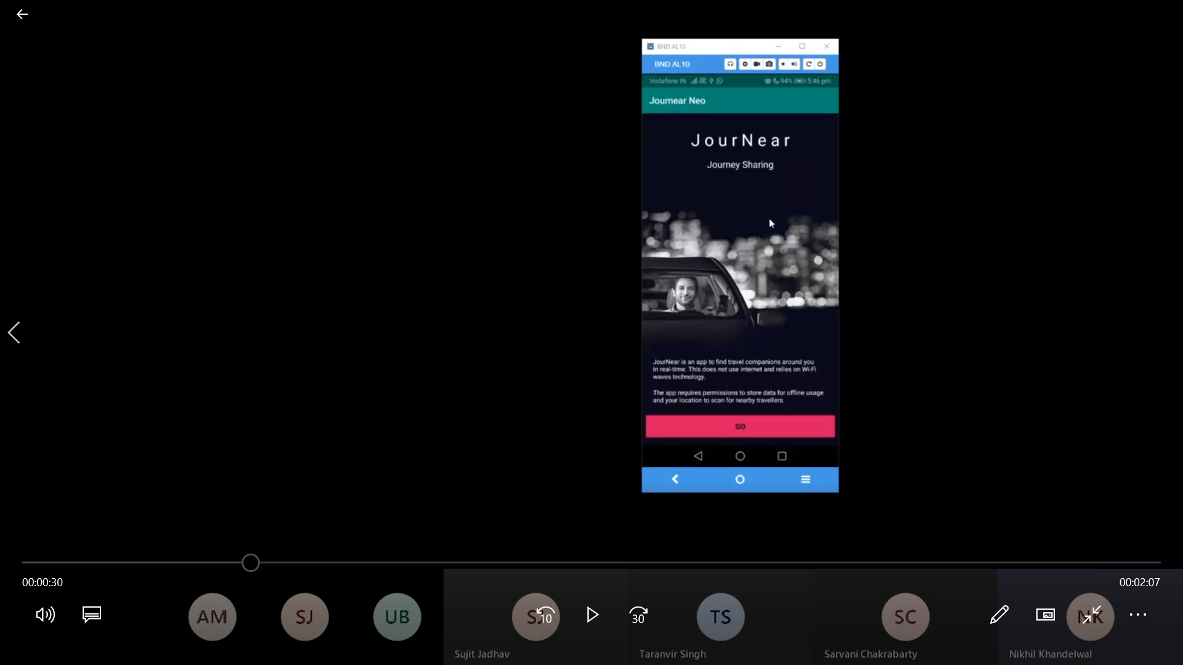
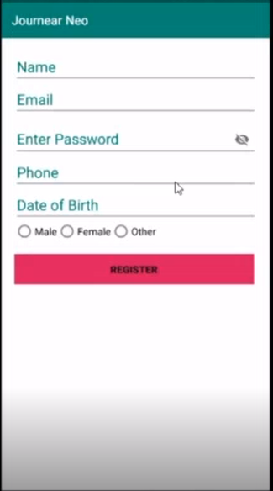
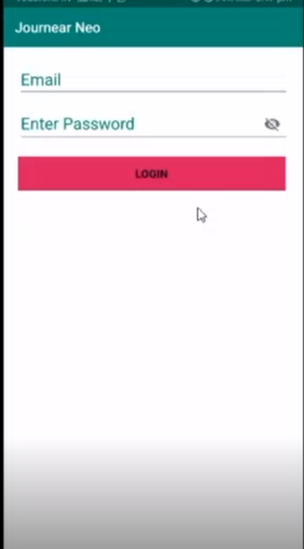
Screenshots of application
Place your screenshot here
Place your screenshot here
Notes:
Moving on to our application which is called JourNear, we provide some screenshots of the application here. The first one shows the home screen of the application. Then comes the registration screen of the application followed by the login activity screen.

Slide 7
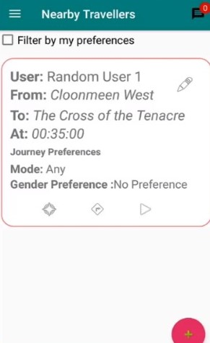
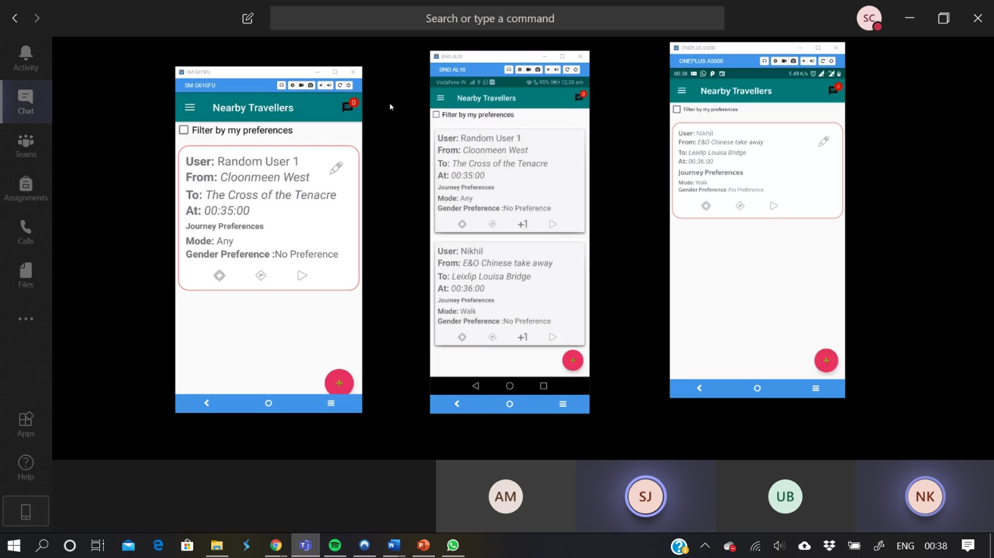
Screenshots of application (discovery)
Place your screenshot here
Place your screenshot here
Place your screenshot here
Notes:
These screenshots show 3 different devices participating in a network at the same time.
We will see the complete workflow of the application in the video demonstrations.

Slide 8
Challenges
Working with Android and Java
Moving among the pairs and passing knowledge
Lack of android devices
Team members located at different Geographical locations and time zones
Using XP programming development, following the best software development practices was difficult
Notes:
Although the project had a huge learning curve, there were some obstacles faced during the project timeline. Working with Android was a challenge at first as the team members were not particularly familiar with Android. Also, since every individual had their own unique way of coding, programming in pairs proved to be quite difficult initially. Forming the pairs taking into consideration the different elective schedules of the team members took some time. Since the project involved peer to peer communication, 2 or more android devices were necessary. That was a problem once the lockdown started and the team had to work remotely. Pair programming also suffered temporarily due to different geographical locations and time zones. Extreme programming imposed some restrictions on coding standards due to which complete creativity in codes were unable to be properly explored. Since the XP process changes quite often, it becomes a challenge to document each and every change throughout the same. Facing the hurdles and overcoming most of them helped in increasing the learning curve even further.

Slide 9
Future Scope
Integration of more features in the User Interface
Integration of ride hailing apps such as Uber with payment options integrated with the app
Enhance Map navigation such as finding optimal path using dynamic routing
Enhance Security and fault tolerance of the application
Giving users more filters and preferences to find the rides
Use of AWS or HaProxy for load balancing
Notes:
There are several ways to improve the app performance and features in the future. The current communication method could be scaled to incorporate several multiple connections with other devices for greater performance. By integrating ride-sharing application such as Uber with applications which provide information about the various public transport methods, there could be a single application which could adhere to users' travel planning. The offline map navigation could be enhanced with better route finding algorithms and the ability to dynamically recalibrate the route if needed. The security of the app could always be further enhanced to make the communications private and resistant to attacks. The fault tolerance attribute of the app is what sets it apart from the other apps in the market and further enhancing this feature is of utmost importance. Enhancing the UI and incorporating more filters based on customer feedback would be beneficial. To ensure high availability to the user, we could use AWS or HaProxy for effective load balancing.

Slide 10
Thanks!
Notes:
Thanks

